Slide 1
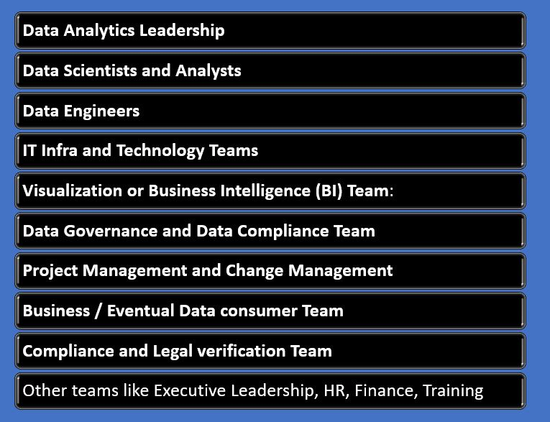
Basics of Data Engineering – Part 3
What is a Data Pipeline?
A data pipeline is like a well-organized system
of actions and tools that automatically gather,
change, and transport data from different places to
one central spot, usually a place where data can be
analyzed or used for making decisions. Usually this
involves moving a data from the Data generator to
a data consolidator.
Data pipelines are crucial for data management,
ensuring data is accessible, accurate, and timely.

Slide 2
Basics of Data Engineering – Part 1
Key Considerations in creating Pipelines
Data Quality: Understand the quality of what is right data and what is not.
Scalability: Ensuring the solution can handle increasing data volumes.
Security: Design pipelines based on sensitivity of data throughout the pipeline.
Monitoring and Logging: Based on requirements of real-time monitoring and detailed logging.
Few popular tools used in Pipeline creation
Apache Airflow – Creates workflow
Talend
Apache Kafka- Streaming platform
AWS Glue- Amazons ERL solution
Google Cloud Dataflow- Google cloud offering
Microsoft Azure Data Factory
Informatica PowerCenter
Few best practices in creating Data pipelines
Implement Data Quality rules during creation
Check on Modular and Reusability consideration
Proper Documentation explaining features
Implement modes of Backup and Recovery
Monitor for Performance Tuning

